Slide 1

Chatbot
Team: Codabyte
Data-path limited

Slide 2
Challenge for JULY CSM Team
Lots of Email
Report Finding
Large number of phone call for simple FAQ or Process status
Balance Checking
Lost of user data searching
Availability
User don’t want to install more app in their phone for communication
Quick Response
Quick Authentication
Handle another CSM query if not present
Finding User Requested data quickly
Human makes mistake when finding and deliver information from large volume of data and it’s very time consuming works for CSM. CSM wants to work on real issue/case instead of just find and deliver the information from system.

Slide 3
Proposed solution
Information request from any popular messaging app (e.g. messenger) ,Smart home device(e.g. Alexa) ,SMS, JULY website chat.
Automated response for user query with authentication and satisfy security compliance.
Understand user question and give proper answer without any human help
User intention detection using business logic and answer accordingly
JULY will get insight of user question answer and feedback from log and take action accordingly.

Slide 4
Chatbot

Slide 5

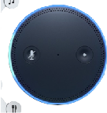




Chatbot - Features
Text and speech language understanding: powered by the same technology as Amazon Alexa
Deployment to chat services
(Web/Mobile Apps, Facebook, Kik, Slack, Twilio SMS, Alexa)
Designed for builders: efficient and intuitive tools to build conversations; scales automatically
@
Versioning and alias support

Slide 6




Deployment to chat services
Chatbot
Facebook Messenger
Build once and deploy for all popular chat, smart home device or JULY website
Twilio SMS
. . .
Authentication
Amazon Lex
Mobile

Slide 7
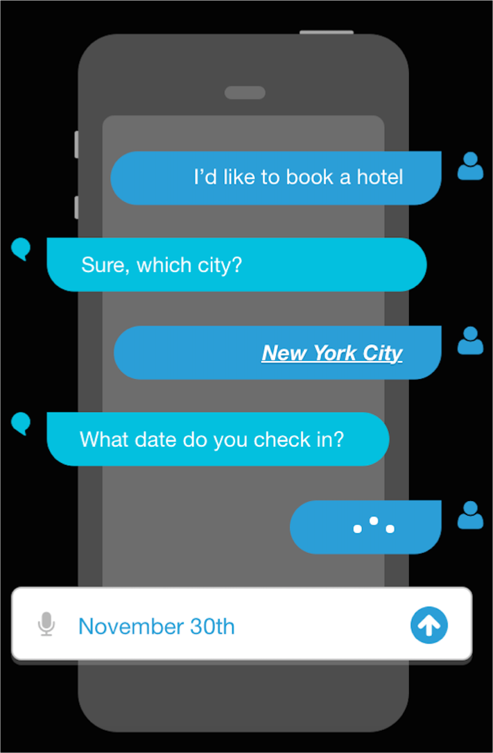
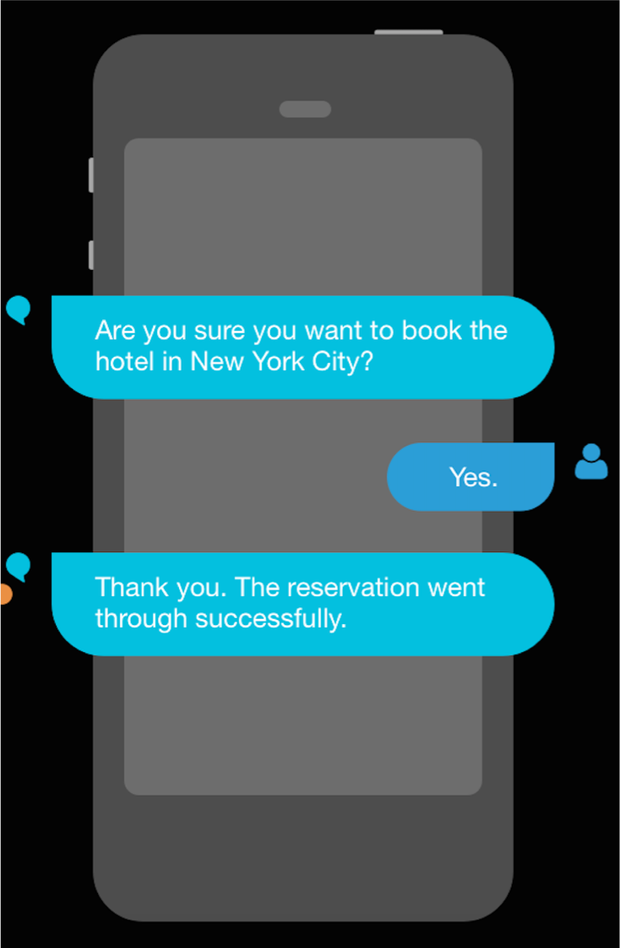
Chatbot – Skill build (AWS Lex or Alexa Skill)
Intents
An intent performs an action in response to natural language user input
BookHotel
Utterances
Spoken or typed phrases that invoke your intent
Slots
Slots are input data required to fulfill the intent
Fulfillment
Fulfillment mechanism for your intent

Slide 8
Utterances variation detection
What is my distribution status
What is my distribution request status
Can you help me with my distribution status?
I am Mahbub, What is my distribution status?

Slide 9
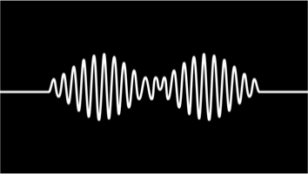

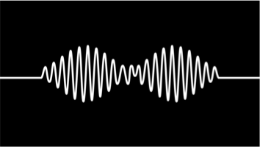
“What is my distribution status”
what
is
my
distribution
distribution
status
status
“What is my distribution status”
Automatic speech recognition
Business logic Intent / slot Model
Natural language understanding
Distribution Status
Project ID | 123456
Other Info (If need)
Other Info (If need)
Utterances
“what is your project id?
“ Your distribution has been paid out on Jan 10, 2019 ”
“ Your distribution has been paid out on Jan 10, 2019 ”
Chatbot

Slide 10
Amazon Lex – technology
Multi-Platform Clients: Mobile, IoT, Web,
Chat
AWS Services
Amazon Cognito
CloudTrail
CloudWatch
SDK
Output:
Speech (via Amazon Polly TTS) or Text
Authentication & Visibility
Input: Speech or Text
End Users
Amazon Lex
Action
AWS Lambda
Intents, Slots, Prompts, Utterances
Fulfillment
Console
Speech API
Language API
API
AWS RDS
Automatic Speech Recognition (ASR)
Natural Language Understanding (NLU)
Developers
MySql
Same technology that powers Alexa

Slide 11
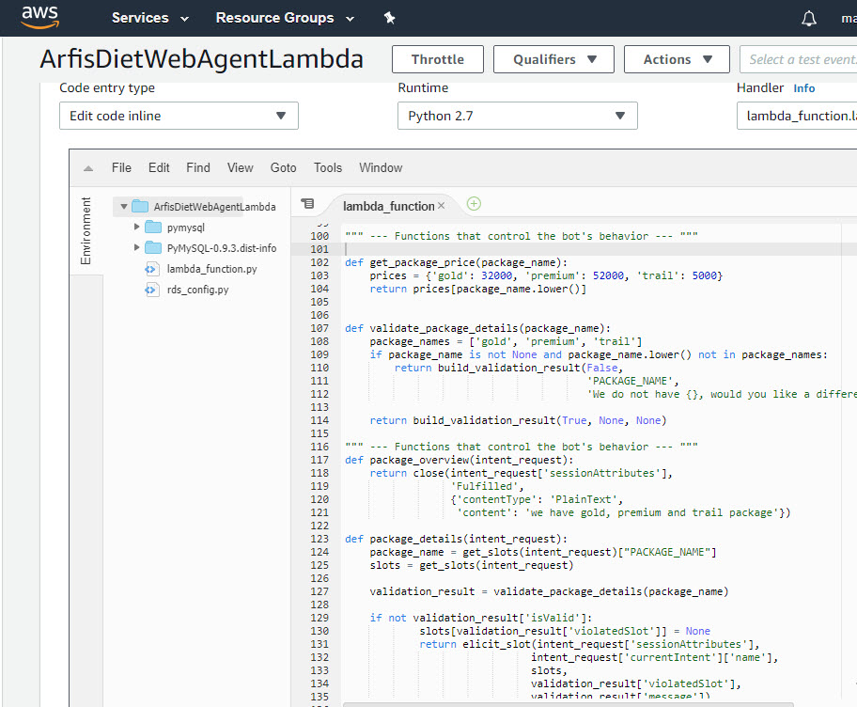
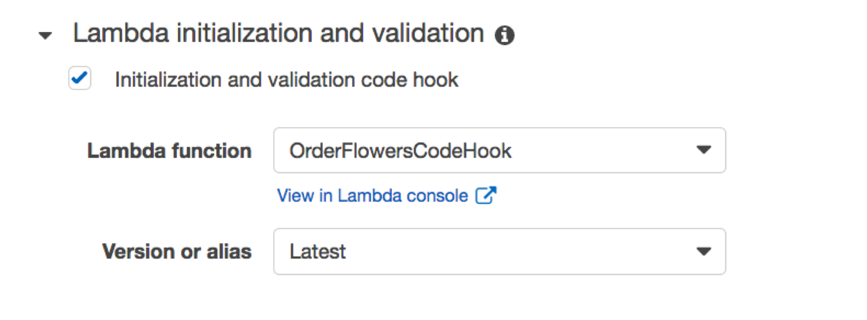
Business logic provided by Lambda

Slide 12

What about if user could call JULY chat bot?
Unanswered query forward to respective CSM (Chat or call)
Automated Email conversation response

Slide 13

Thank you
If have any question or want to know more, please contact with Codabyte team

